Slide 1
Weekly Update #17
Gijs Admiraal

Slide 2
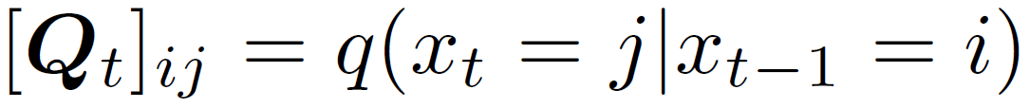
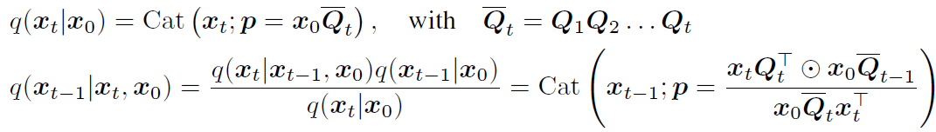
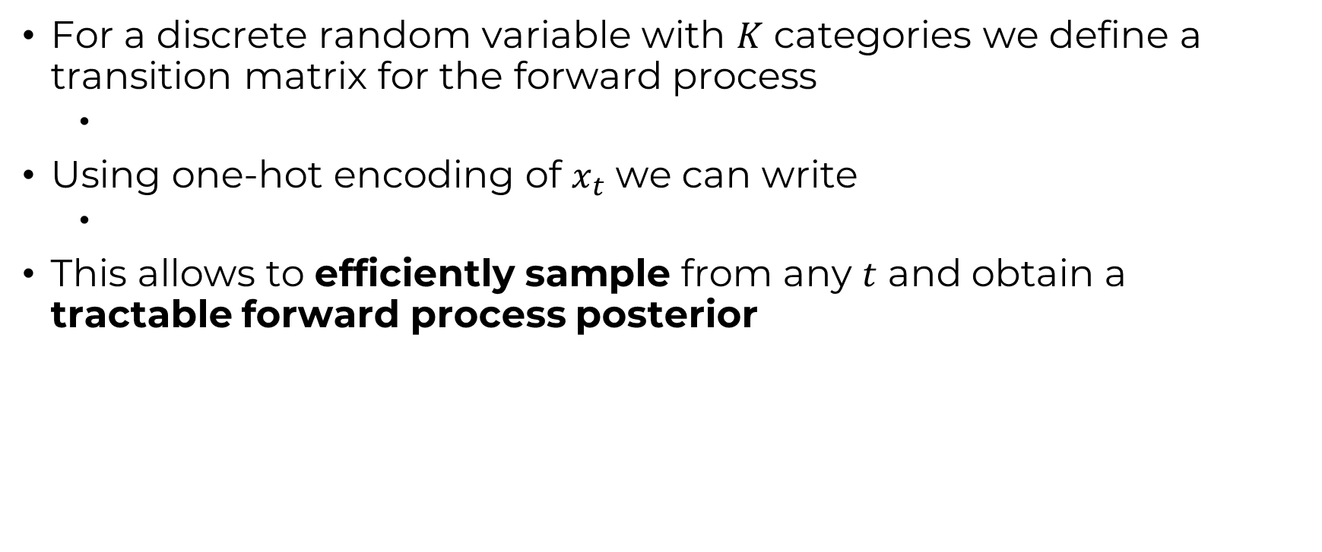
Discrete DDPM (D3PM)
For a discrete random variable with $K$ categories we define a transition matrix for the forward process
Using one-hot encoding of $x_{t}$ we can write
This allows to efficiently sample from any $t$ and obtain a tractable forward process posterior

Slide 3

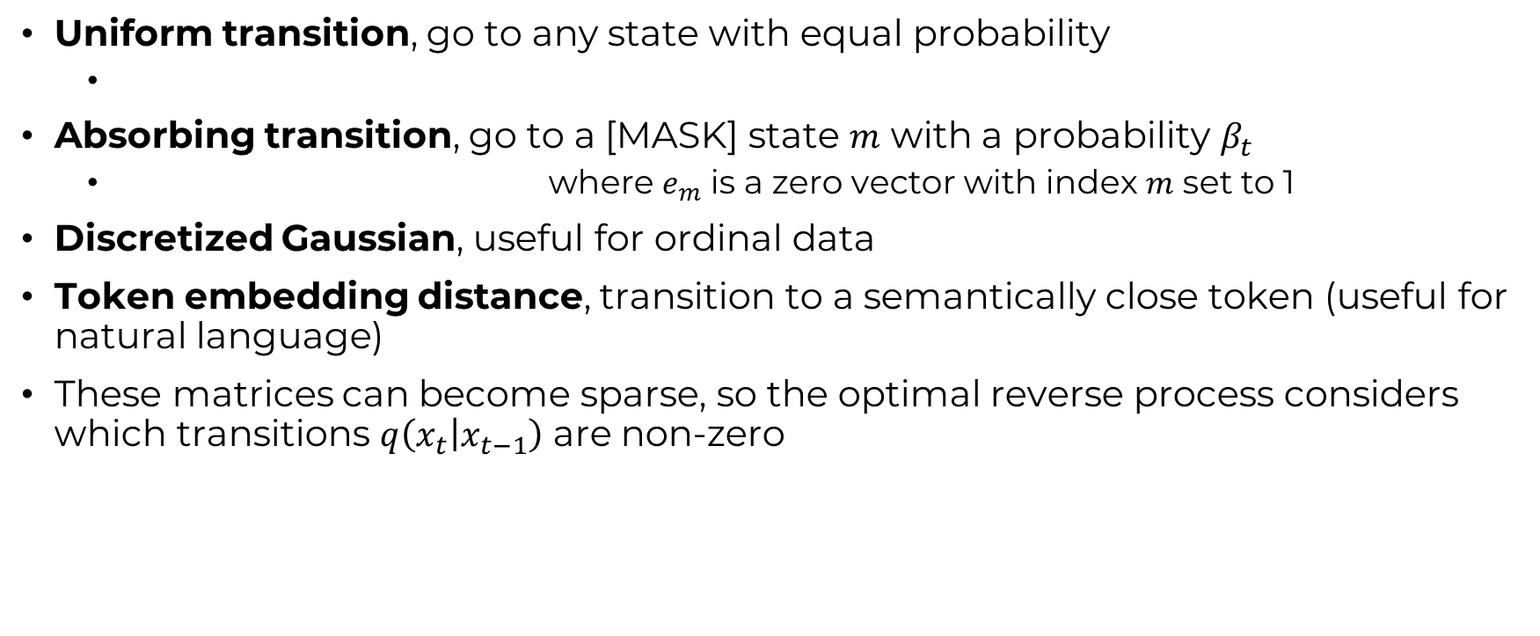
Transition matrices
Uniform transition, go to any state with equal probability
Absorbing transition, go to a [MASK] state $m$ with a probability $β_{t}$
where $e_{m}$ is a zero vector with index $m$ set to 1
Discretized Gaussian, useful for ordinal data
Token embedding distance, transition to a semantically close token (useful for natural language)
These matrices can become sparse, so the optimal reverse process considers which transitions $q\left(x_{t} | x_{t−1}\right)$ are non-zero

Slide 4
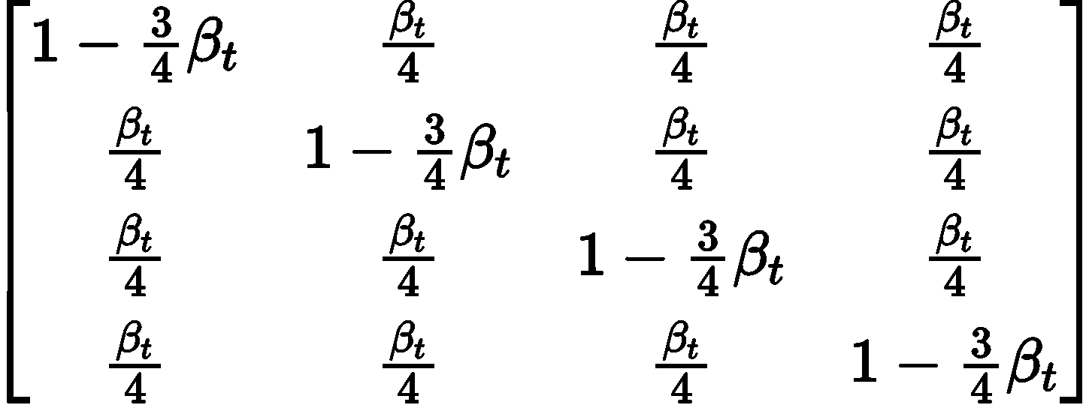
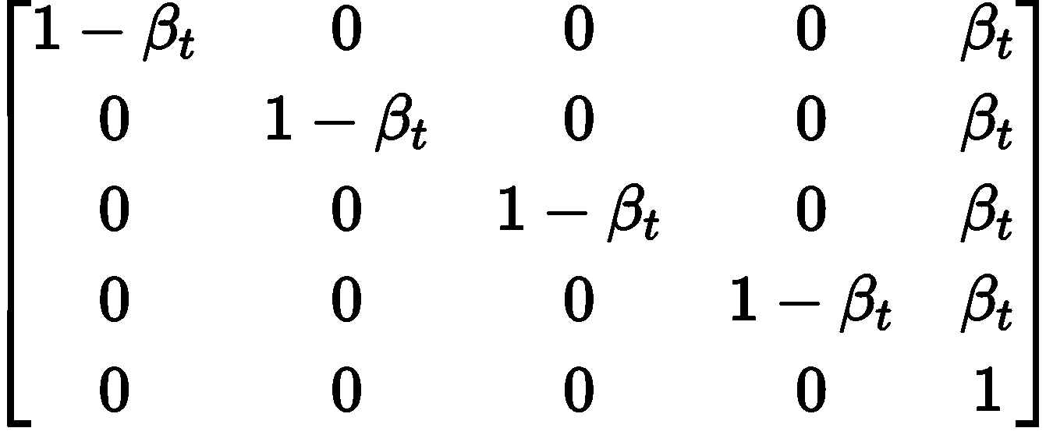
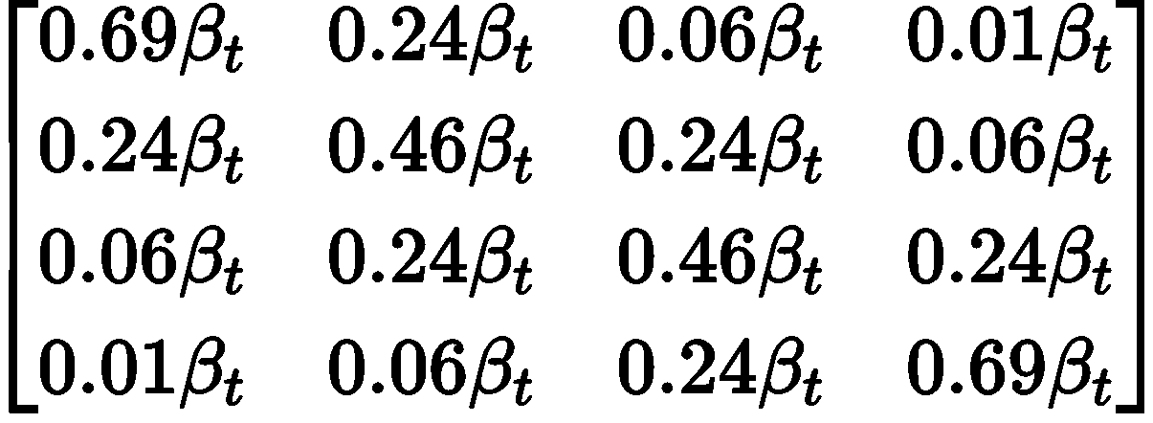
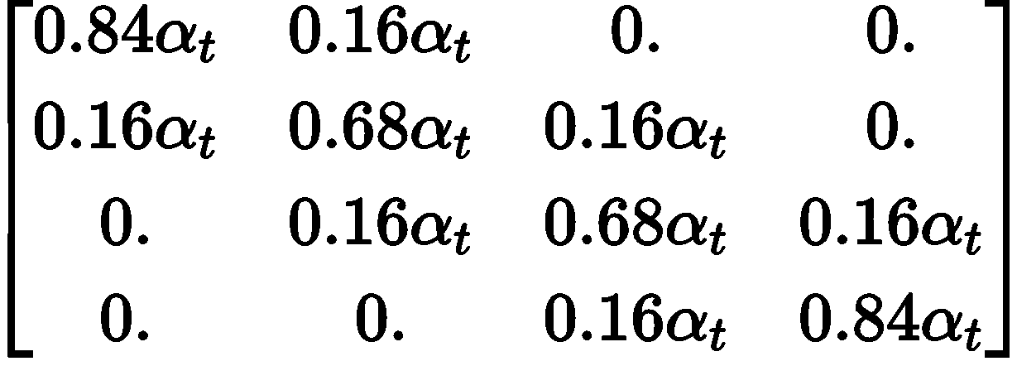
Transition Matrix example
Uniform
Absorbing state
1
2
3
4
1
2
3
4
M
1 2 3 4
1 2 3 4 M
Discrete Gaussian
Token embedding
1
2
3
4
1
2
3
4
1 2 3 4
1 2 3 4
In reality we want a matrix that maintains a uniform stationary distribution

Slide 5
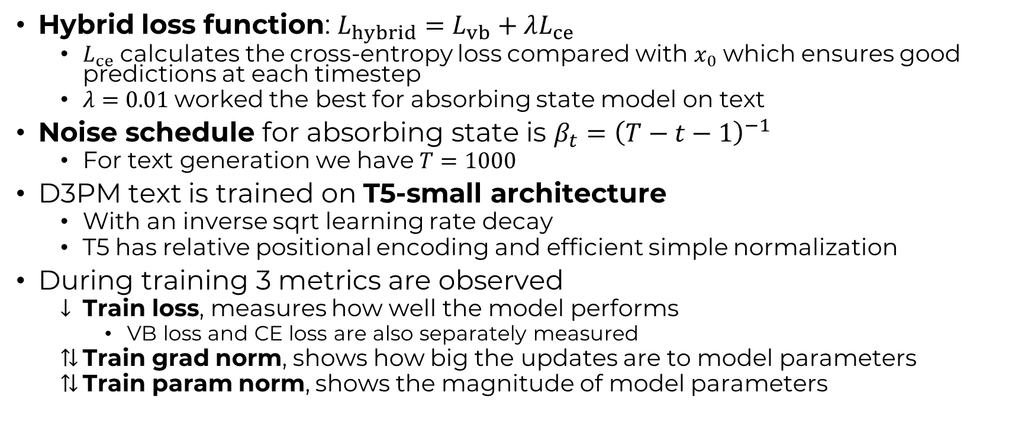
D3PM
Hybrid loss function: $L_{hybrid}=L_{vb}+λL_{ce}$
$L_{ce}$ calculates the cross-entropy loss compared with $x_{0}$ which ensures good predictions at each timestep
$λ=0.01$worked the best for absorbing state model on text
Noise schedule for absorbing state is $β_{t}={\left(T−t−1\right)}^{−1}$
For text generation we have $T=1000$
D3PM text is trained on T5-small architecture
With an inverse sqrt learning rate decay
T5 has relative positional encoding and efficient simple normalization
During training 3 metrics are observed
Train loss, measures how well the model performs
VB loss and CE loss are also separately measured
Train grad norm, shows how big the updates are to model parameters
Train param norm, shows the magnitude of model parameters

Slide 6
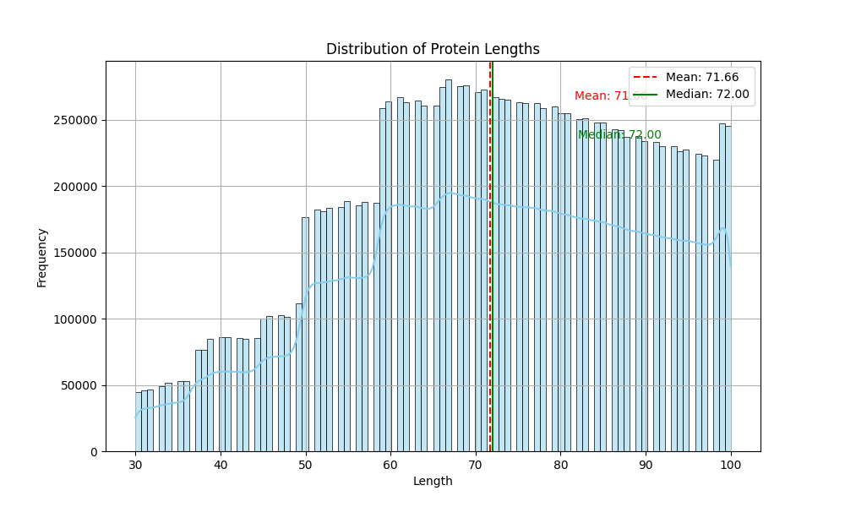
UniRef50
Created a training/validation/test split (0.8/0.1/0.1)
AA sequence
Vocabulary: 20
Lengths: 30-72-100
Atom sequence
Vocabulary: 21
Lengths: 402-967-1343
F-group sequence
Vocabulary: 15
Lengths: 47-115-160

Slide 7
This week?
Decided on architecture
Created the architecture
Similarities to MLMs
Details on functional group code
More distribution analysis

Slide 8
Architecture? – T5
What do we want our architecture to do?
Given a corrupted sequence and a timestep give a slightly less corrupted sequence
BERT outputs probabilities of vocabulary
Less complex since only the encoder part of a transformer
Works well for sequence understanding
GPT outputs a sequence
Less complex since only the decoder part of a transformer
Works well for next token prediction (sequence finishing)
Transformer (T5) outputs a sequence
More complex but not always a bad thing
Works better for our generative setup
Transformer architecture used in other sequence diffusion models
D3PM, DPLM

Slide 9
Progress on T5
Converted some code from FLAX to PyTorch
Changed some T5 PyTorch code to include timesteps
Model builds correctly
Small bug in the decoder for forward pass

Slide 10
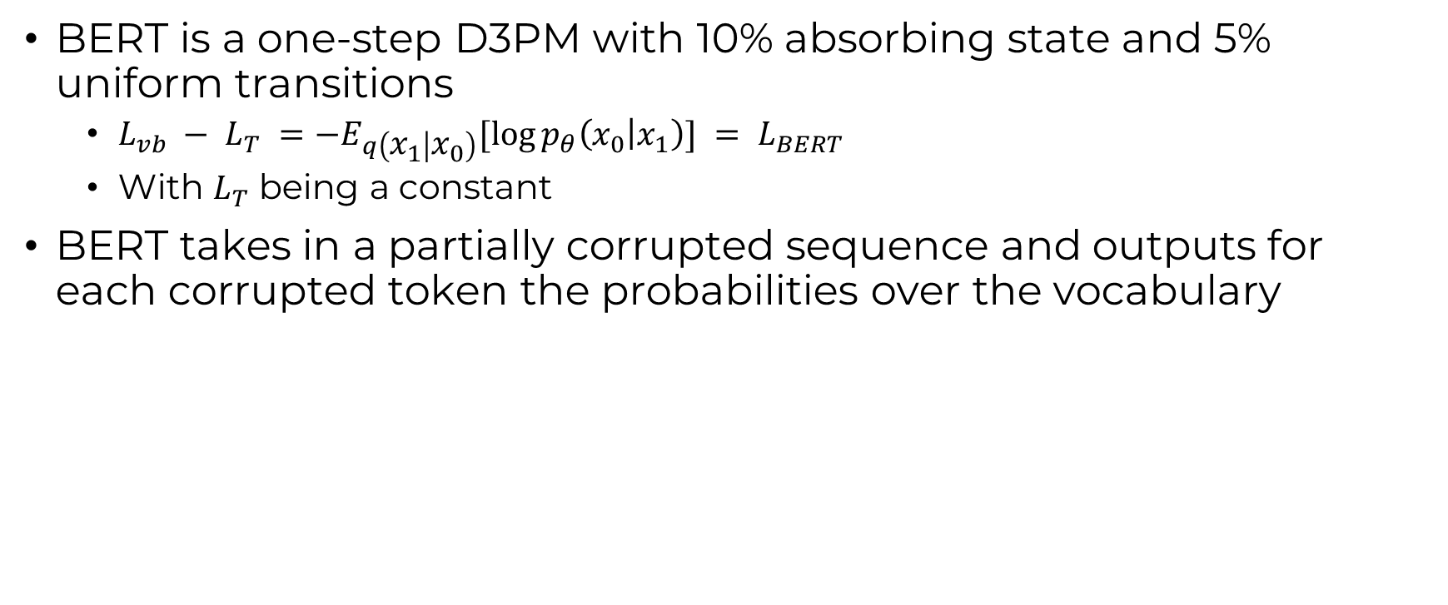
Similarities to MLM
BERT is a one-step D3PM with 10% absorbing state and 5% uniform transitions
$L_{vb} − L_{T} =−E_{q\left(x_{1} | x_{0}\right)}[\log{p_{θ}\left(x_{0} | x_{1}\right)}] = L_{BERT}$
With $L_{T}$ being a constant
BERT takes in a partially corrupted sequence and outputs for each corrupted token the probabilities over the vocabulary

Slide 11
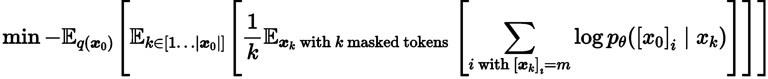
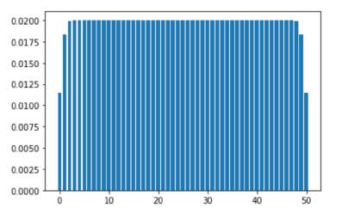
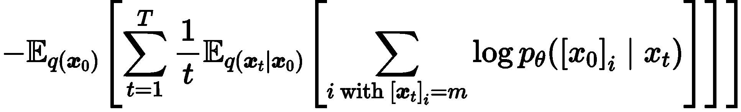

Similarities to MLM
Generative Masked Language Models (MLMs) mask $k$ tokens
Objective MLMs
Objective of D3PM can be simplified (when using a reparameterization)
Unmasked tokens have a KL-divergence of 0
Masking transitions in KL-divergence set to constant (not dependent on $θ$)
Taking noise schedule $β_{t}=1/(T−t+1)$
New objective
Masking is computed independently with a reweighted version
Mask each token with a reweighted prob $p≈k/T$
Similar to a mixture of binomials

Slide 12
Functional groups
Functional Group Algorithm¹ – How are the groups found?
Mark all hetero atoms in a molecule (not a carbon or hydrogen atom)
Mark “interesting” carbon atoms
Dependent on their bonds, connected atoms or part of specific rings
Merge all connected marked atoms to a single FG
Extract FG
Logically what are the amino acid groups?
Carboxyl acid CO₂H, amine NH₂ and alpha carbon CH
Side chains: Methyl (CH₃), Thiol (CH₂SH), Carboxyl#2 (CH₂CO₂H), Carboxyl#3 ( CH₂CH₂CO₂H), etc..
Looks a lot like each side chain is its own functional group

Slide 13
More distributions
Getting the SELFIES/FN distribution per length takes a long time
Getting the aa distribution per length is saved
But plotting takes a long time?
Cluster is busy again today

Slide 14
Next week?

Slide 15
Notes

